Slide 1




Forecasting Forensic Services Utilization Rates
Sherri McRae

Slide 2


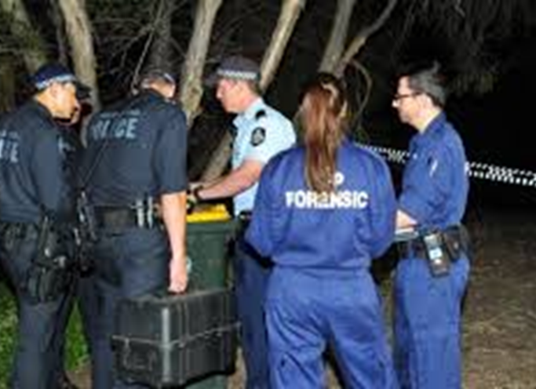
Forecasting Utilization Rates Victoria Police Forensic Services

Slide 3
Notes to follow up
What is the best method to predict utilization rates for different offence categories.
Provide list of offence categories
Include other models: ie; Bayesian models
Research: Flat line forecast, Bayesian models predicting time series data, more research on how spatial data can be used to predict crime
Contents page:
Conclusions page: which models work best

Slide 4

the data
utilization rate = number of cases (PALM)
number of cases (LEAP)

Slide 5
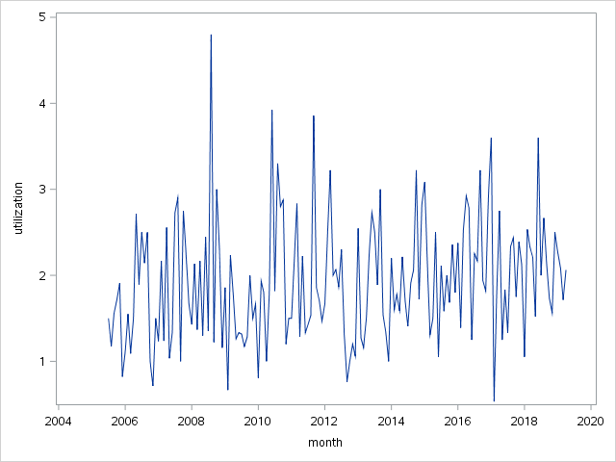
Homicide Utilization Rates

Slide 6
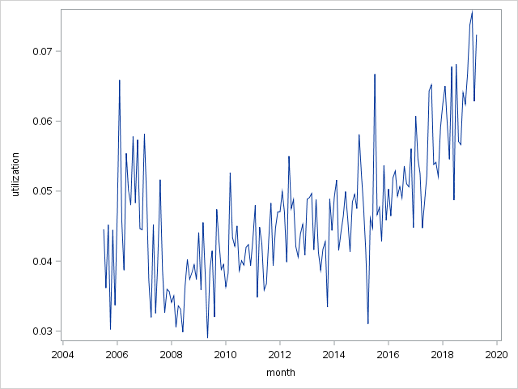
Burglary (Residential) Utilization Rates

Slide 7
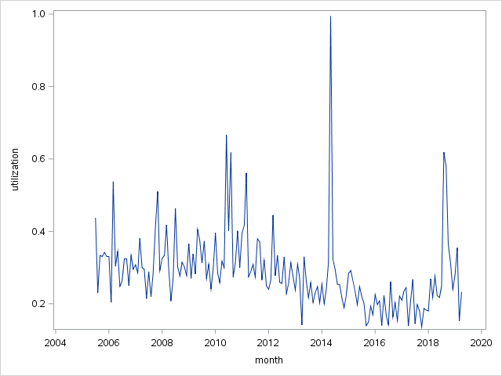
Rape Utilization Rates

Slide 8
the forecasts
Time series models:
ARIMA vs. exponential smoothing

Slide 9
Methodology
Proc ARIMA
Proc ESM
Quality metrics: RMSE, MAPE, AIC, BIC

Slide 10
Complex Models
Time series models:
ARIMA vs. exponential smoothing

Slide 11
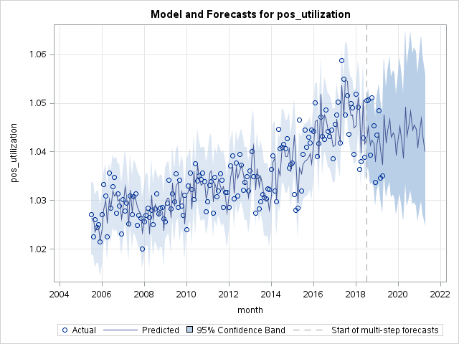
ESM Forecast for Overall Utilization
Model: Winters [log(x + 1) transform]

Slide 12
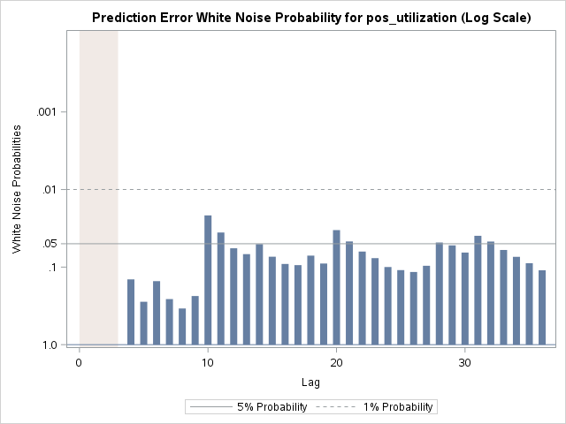
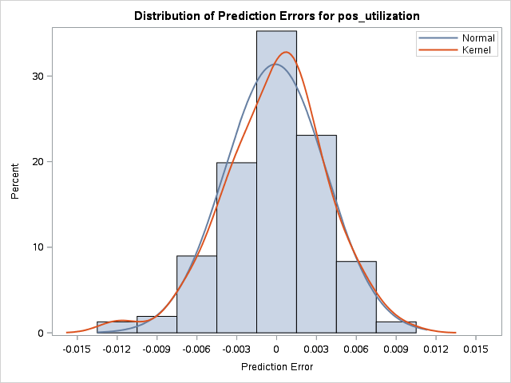
ESM Model Errors Overall Utilization

Slide 13
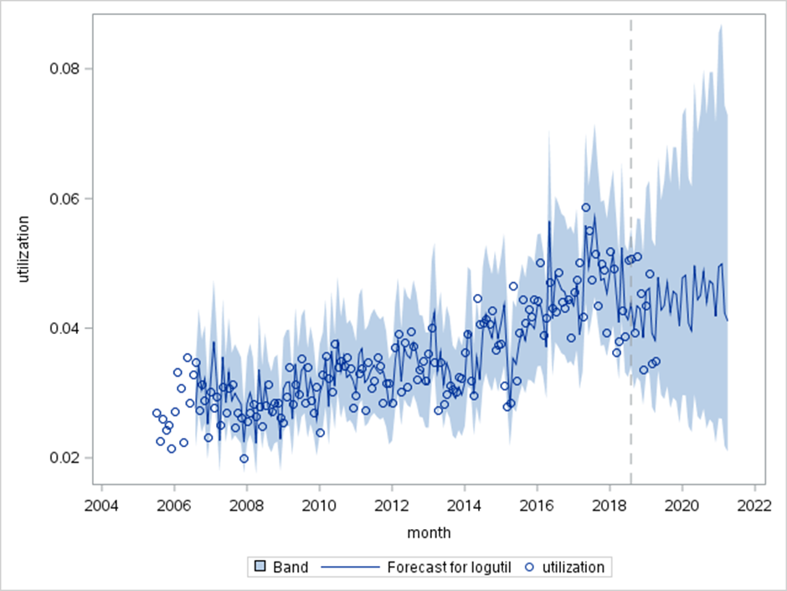
SARIMA Forecast for Overall Utilization (1)
Model: SARIMA(3,1,1)x(0,1,1)₁₂ [log transform]

Slide 14
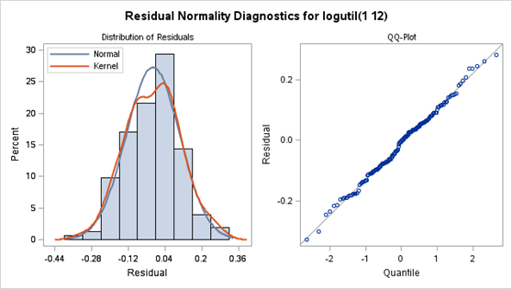
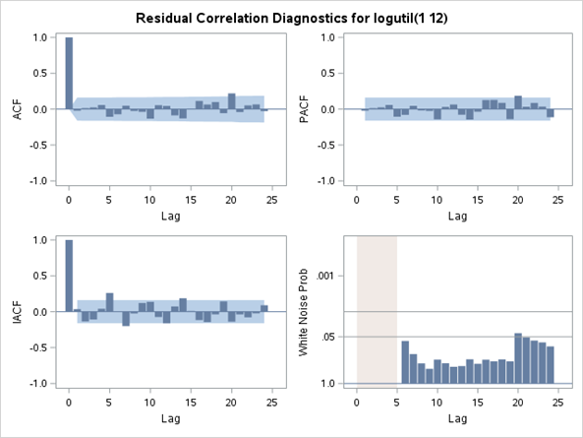
SARIMA Model Errors Overall Utilization (1)

Slide 15
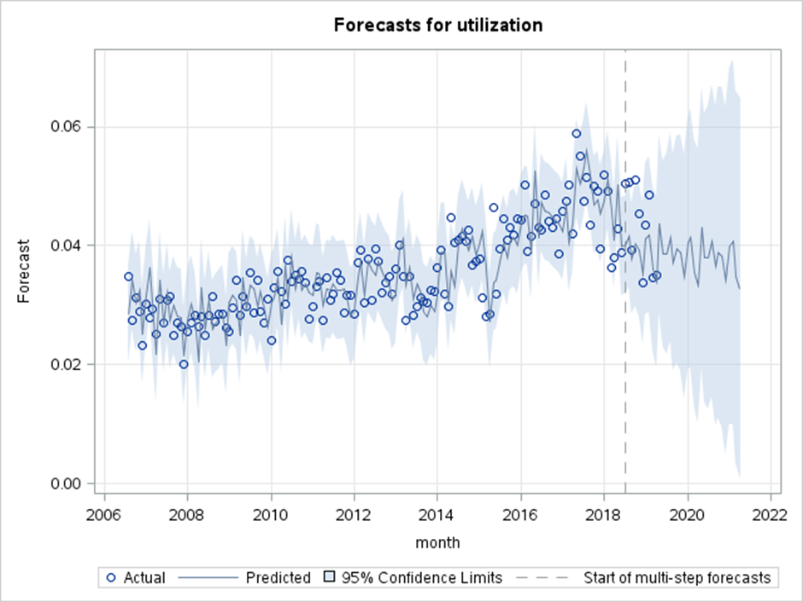
SARIMA Forecast for Overall Utilization
Model: SARIMA(2,1,0)x(0,1,1)₁₂
Model: Winters [log(x + 1) transform]

Slide 16
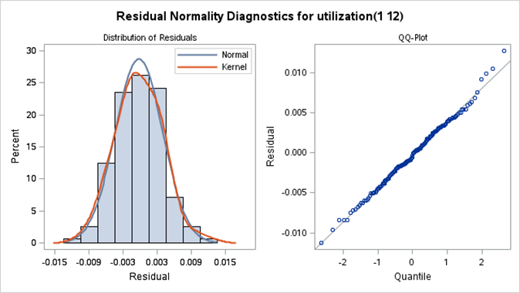
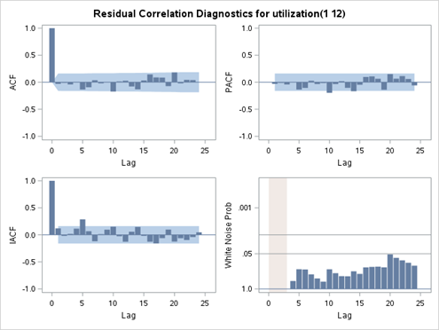
SARIMA Model Errors Overall Utilization

Slide 17
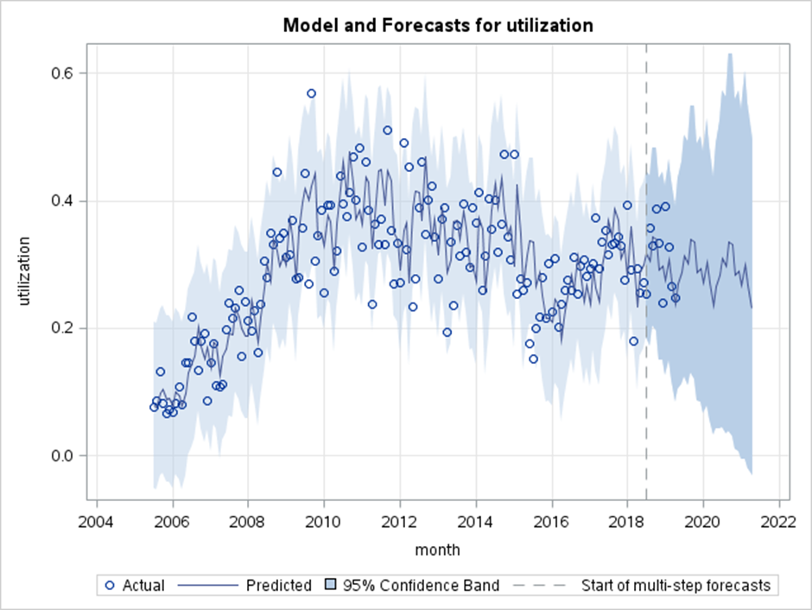
ESM Forecast for Drugs (Cult/Manu/Traf)
Model: Holt Winters

Slide 18
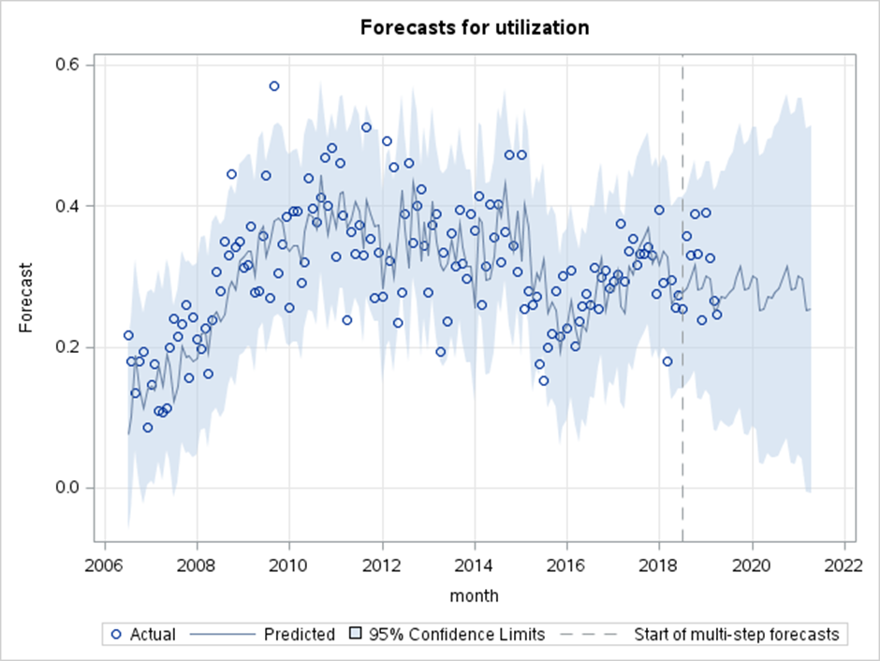
SARIMA Forecast for Drugs (Cult/Manu/Traf)
Model: SARIMA(2,0,1)x(0,1,1)₁₂
Model: Winters [log(x + 1) transform]

Slide 19
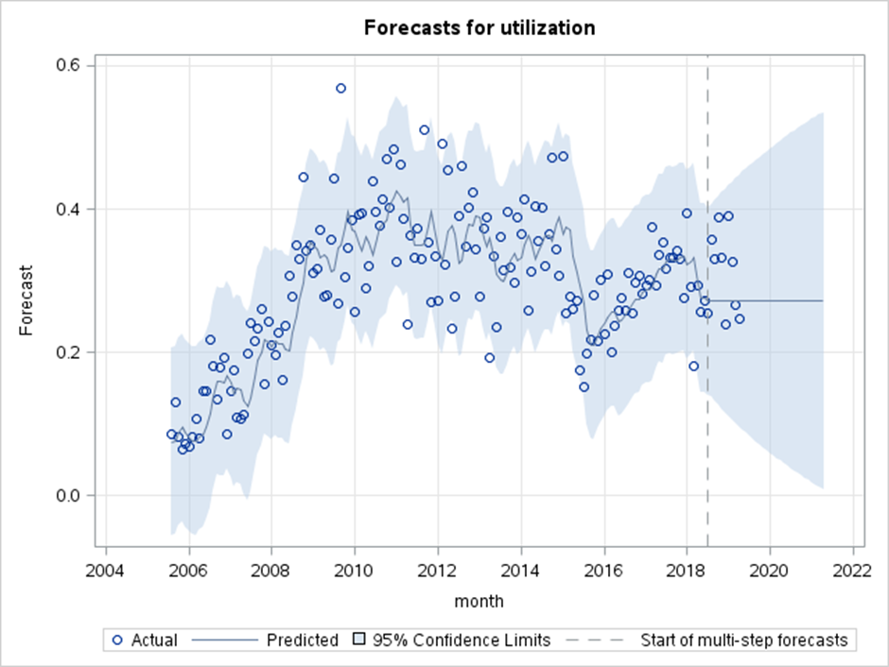
ARIMA Forecast for Drugs (Cult/Manu/Traf)
Model: ARIMA(1,1,1)

Slide 21
Outliers
Time series models:
ARIMA vs. exponential smoothing

Slide 22
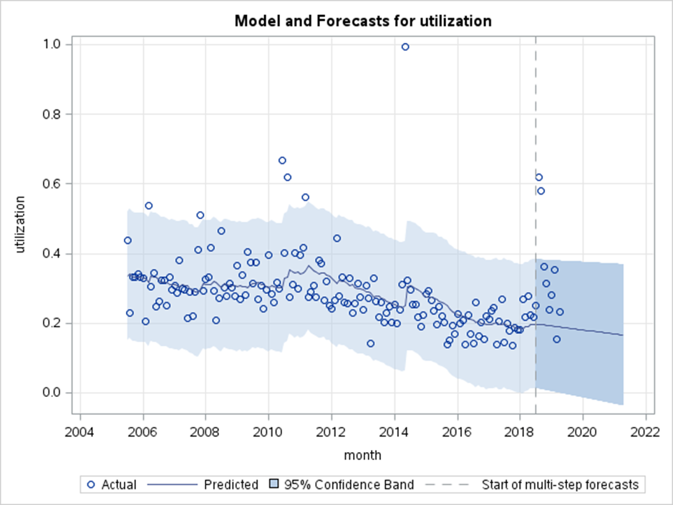
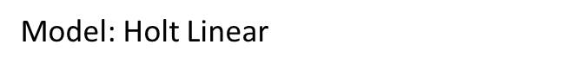
ESM Forecast for Rape (1)
Model: SARIMA(2,1,0)x(0,1,1)₁₂
Model: Winters [log(x + 1) transform]

Slide 23
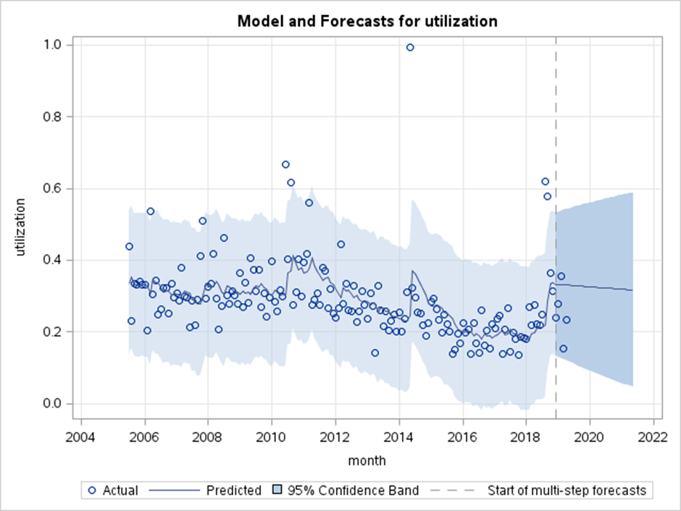
ESM Forecast for Rape (2)
Model: Holt Linear
Model: SARIMA(2,1,0)x(0,1,1)₁₂
Model: Winters [log(x + 1) transform]

Slide 24
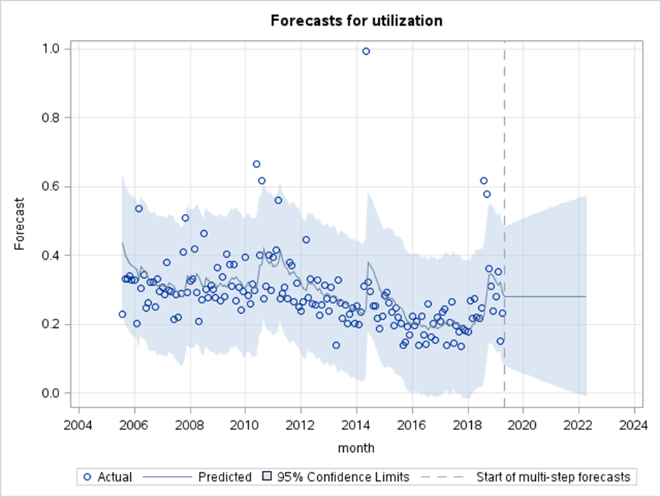
ARIMA Forecast for Rape (1)
Model: ARIMA(0,1,1)
Model: SARIMA(2,1,0)x(0,1,1)₁₂
Model: Winters [log(x + 1) transform]

Slide 25
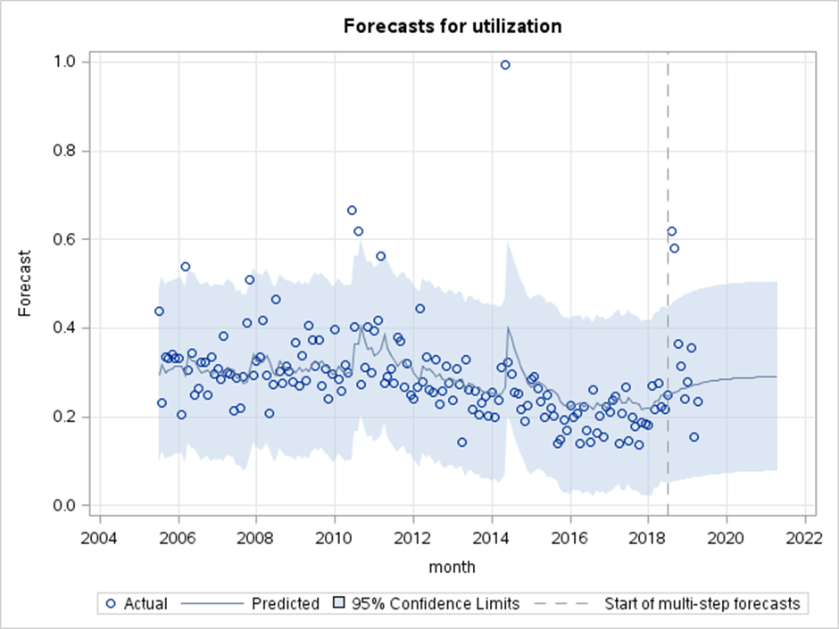
ARIMA Forecast for Rape (2)
Model: ARIMA(1,0,1)
Model: Winters [log(x + 1) transform]

Slide 27
Flat Forecasts
Time series models:
ARIMA vs. exponential smoothing

Slide 28
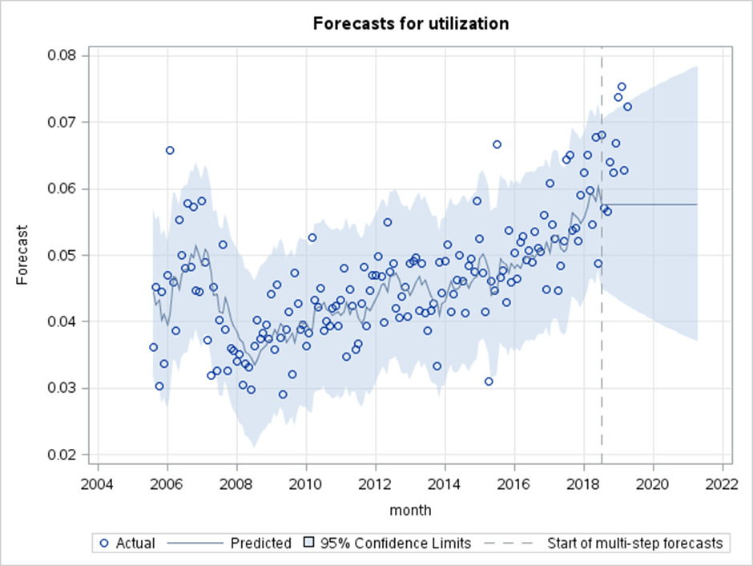
ARIMA Forecast for Burglary (Residential)
Model: ARIMA(0,1,1)
Model: Winters [log(x + 1) transform]

Slide 29
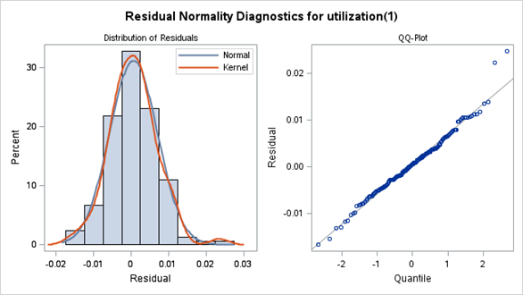
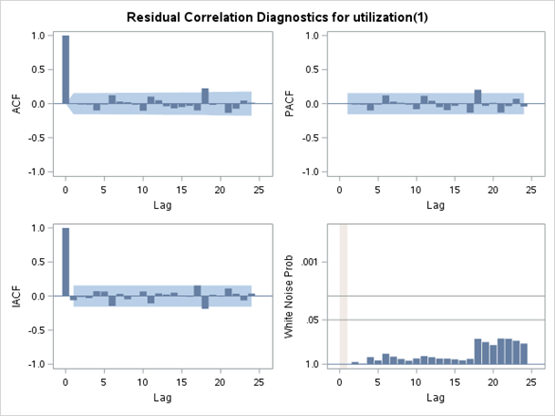
ARIMA Model Errors Burglary (Residential)

Slide 30
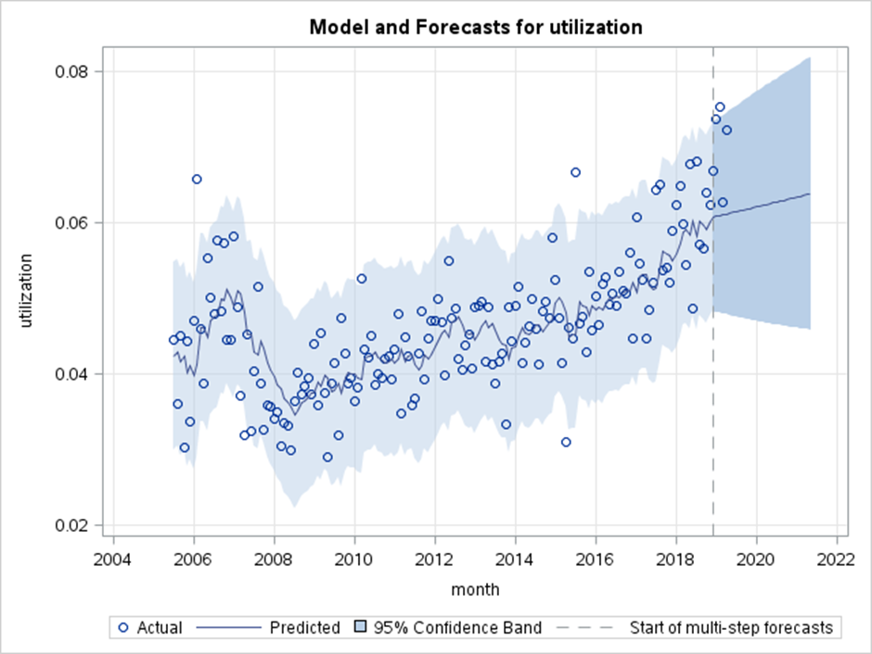
ESM Forecast for Burglary (Residential)
Model: Holt Linear
Model: Winters [log(x + 1) transform]

Slide 31
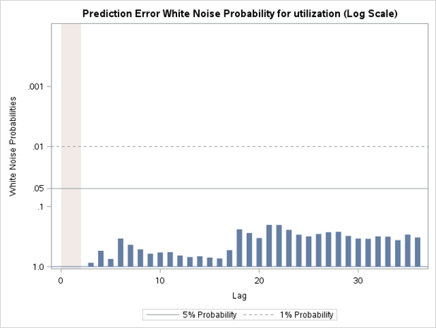
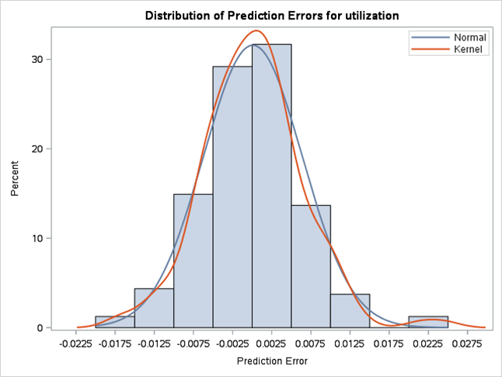
ESM Model Errors Burglary (Residential)

Slide 32
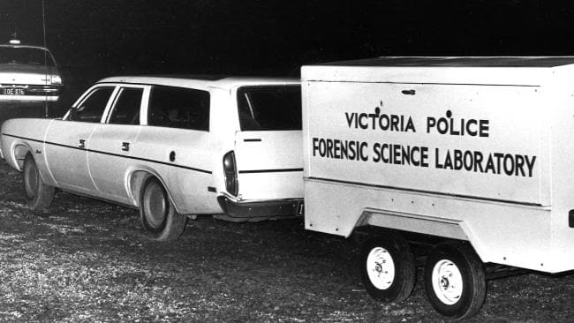
In conclusion . . .

Slide 33
conclusion
Proc ESM good place to start for assessing these datasets
If the errors are not normally distributed or show autocorrelation:
Move to ARIMA and SARIMA models.

